Slide 1
Chapter 9 Testing the System
Note A: unit and integration testing----by yourself
or a small part of the development
team（you can complete control
over the testing process.）
B: system testing----by the entire development
team (you can’t control the testing
process，you must work with the
entire development team.）
[  ]

Slide 2
Component code
Unit
test
Design
specifications
System
functional
requirements
Other
Software
requirements
Customer
Requirements
definition
User
environment
Tested Component
Component code
Unit
test
Integration
test
Function
test
Performance
test
Acceptance
test
Installation
test
Tested Component
Integrated
modules
Functioning
system
Verified
Validated
software
Accepted
system
Component code
Unit
test
SYSTEM
IN USE!
System testing
Fig 8.3 Testing steps.

Slide 3
Chapter 9 Testing the System
9.1 Principles (原理) of System Testing
Focus A: The objective of unit and integration
------ensure the code implemented
the design properly
(程序员/测试者满足设计师的设计要求)
B: The objective of system testing
------ensure the customer wants it to do
(开发团队确保系统满足客户的需求)
软件的最终要求

Slide 4
Chapter 9 Testing the System
1. Sources of Software Faults (软件缺陷的来源)
The objective(目标)of testing : eliminate all faults
that might lead to failures
appearance of faults : can be inserted in any
phase during software process (Fig9.1)
A: faults in the requirement (uncertain, incorrect,
missing, misunderstand，etc.)
B: faults in the system design(incorrect or
unclear design, incorrect translation
from SRS) （有时低效的设计进一步维
护时产生紊乱，新的缺陷难以检测）

Slide 5
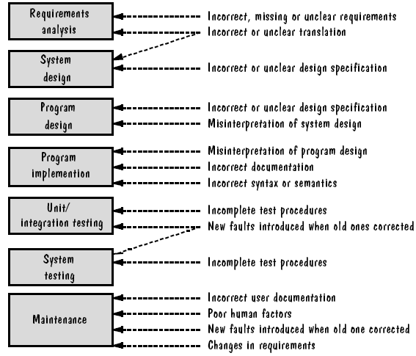
Chapter 9 Testing the System

Slide 6
Chapter 9 Testing the System
C: faults in the program design
( incorrect or unclear program design,
misinterpretation of system design )
D: faults in coding
( incorrect documentation, incorrect semantics,
misinterpretation of program design )
E: faults in unit/integration testing
----incomplete test process
----correct old mistakes generate new errors
(correct 3or4 old bugs, then generate 1 new
bug)-----Microsoft
----(example P419-s4 )

Slide 7
Chapter 9 Testing the System
F: faults in system testing
( incomplete test procedure )
G: faults in maintenance (change requirement,
incorrect user document, poor human factors,
new faults introduced when correct old errors)
● demanding (要求) to testing process
A: thoroughness
B: satisfaction ( by user, customer, developer )
(因为在大型系统中，肯定存在用户允许的、当时不
必修复的缺陷存在)

Slide 8
Chapter 9 Testing the System
2. System Testing Process (Fig9.2)
 Process Objectives（处理过程的各个目标）
A: function test ------check <SRS> by developer
B: performance test -----check <SRS>by developer
C: acceptance test ---check <requirement
definition> by developer and user
D: installation test -----test in user’s environment
 Build Plan（构造/集成计划）
A: system testing of large system
X: phased system testing (from small to large)
Y: nested set of levels (from inner to outside)
安装测试报告

Slide 9
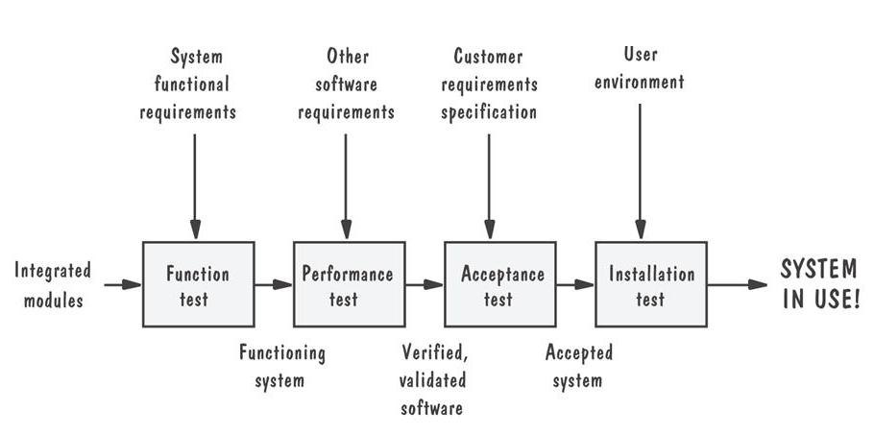
Pictorial representation of steps in testing process

Slide 10
Chapter 9 Testing the System
B: example: routes calls ( in telecommunications
system—5 subsystems ) (P421)
advantage: X: tested one level--deliver one level
Y: easy to check or correct fault
C: build plan ----incremental test plan for large
system( include how,where,when,who )
example: build plan for routes calls subsystem
X: table 9.1 : schedule table
Y: focus on: spin(subsystem ) —hardware
and software resource + time/schedule
+ personnel + customer

Slide 11
Chapter 9 Testing the System
3. Configuration Management (SCM)(配置管理)
 concepts A: system configuration (P423)
（交付给特定客户的一系列部件的集合）
此处重提配置管理，主要是强调大型多版本之下的基本测试原则，及部分回归的概念
A
B
C
D
H
F
E
G
用户1
用户2
A
B
C
D
E
F
A
B
C
D
E
G
H
产品1 产品2

Slide 12
Chapter 9 Testing the System
上图:两个产品具有不同的配置,其中A、B、C、D、
E是核心部件/基本部件。
B: configuration management(P423)（配置管理）
（对系统不同软件配置的管理及控制方法（既有开
发，也有测试），通过控制系统差别以降低风
险，减少错误）。
C: importance: ( of configuration management )
----coordinating efforts effective configuration
协调各方努力 get 有效配置

Slide 13
Chapter 9 Testing the System
 确定配置管理(SCM)计划
配置管理是整个开发过程中,用于管理软件产品内容的一系列措施.SCM流程旨在确保在任何时候产品的内容都是已知的、可用的，以及在设计到实施的过程中，产品的功能都是可跟踪的，可以完全控制和保护产品的内容。（例如曾经流行的配置管理工具clearcase等）
使用配置管理计划的必要性：
如果不使用适当的配置管理计划，我们就经常无法知道哪一个模块是被确定、增强或测试过的。
我们会开发出功能错误或是缺少功能的产品来，而且我们不知道哪些测试正在进行，哪些缺陷已被确定。
我们不得不重新整理已经完成了的工作。

Slide 14
Chapter 9 Testing the System
配置管理计划关键的功能：
每个产品元素（部件）版本的复件；
对每一个基线修改的记录；（修改内容的说明：修改位置，修改时间，修改内容等等）
基线：是指软件文档和其他资料的集合，它们代表了产品在某一时间点的情况(以及其他参考点)。
谁进行了这个改变；
他们什么时候改变的；(控制同时修改只能小规模有序进行)
改变具体内容是什么；
为什么他们要进行改变。
可能涉及的其他功能等等(从涉及的基本文档开始统计)。 (改动配置所进行的测试甚至可发现以前的问题)

Slide 15
Chapter 9 Testing the System
技术支持经理负责草拟配置管理计划，并且和全组一起对它进行复核。
确定配置控制委员会和控制过程
确定任何所需的工具和设备。
和小组一起重申整个计划，并取得一致意见

Slide 16
Chapter 9 Testing the System
软件配置管理的任务
——制定软件配置管理计划
——确定配置标识规则
——实施变更控制
——报告配置状态
——进行配置审核
——进行版本管理和发行管理

Slide 17
Chapter 9 Testing the System
忽视软件配置管理可能导致的混乱现象
发错了版本
安装后不工作
异地不能正常工作
已经解决的缺陷过后又出现错误
开发人员把产品拿出去出售赢利
找不到最新修改了的源程序
找不到编程序的人

Slide 18
Chapter 9 Testing the System
● versions and releases（版本和改进版本）
versions----a particular configuration for a
system（针对特定系统的特定配置）
release----improved version/system
（针对旧版本的改进版本）
example:
Version n.m=Version n and release m
Version 3.0----Version3.1 ，release 3.2
target of configuration management ( in system
testing )----accuracy and promptness in testing
[对于大型系统，人们绝不敢在忽略配置的情况下运行针
对全部版本的测试用例集，一来太庞大麻烦；二来无针对性 ]

Slide 19
Chapter 9 Testing the System
❍ production system vs. development system
A:production system:
B:development system:
■ regression testing（回归测试）
---- a test applied to a new version( verify the
correctness of the old and new functions)
example: version m-----version m+1 (P425)
( test new version by old and new test
cases )
（大型系统的配置更动测试只是“部分”回归测试）

Slide 20
Chapter 9 Testing the System
□Change Control (变更控制) （主题：纳入配置管理）
A: note: system testing ----find faults----correct
faults----change system (under the control
by configuration management team)
B: problem caused by the change
X: change any part of software----effect all
documents and all developers
Y: more developers make change----effect each
other
C: change control: 配置管理小组采取措施使不同开发
者各自修改后的版本统一为一个版本.(使开发者不
同时修改软件同一部分, 或采取其他额外步骤)

Slide 21
Chapter 9 Testing the System
4. Test team
 focus on:
A: unit and integration test----large role is
developers
B: function and performance test----large role is
developers
C: acceptance and installation test– large role
is customers
D: programmers can’t participate the testing of
his own modules

Slide 22
Chapter 9 Testing the System
 several types (about testers)
A: professional testers (who organize and run the
tests, include former analysts,
programmers, and designers) (P429)
B: analysts: ( who created requirement )
C: system designers (who understand SRS and
propose solution)
D: configuration management specialists (who
controls the changing of software)
E: users: to evaluate issues that arise

Slide 23
Chapter 9 Testing the System
9.2 Function Testing
Focus on: A: function testing ----black box
B: function testing ----based on <SRS>
1.Purpose and Roles（目的和作用）
function testing : test for functional
requirement ( of <SRS> )
role: have a high probability of finding a fault
(because one function testing only deal
with the small set of components)
example : water-monitoring system
----acknowledging change in dissolved oxygen,
temperature, acidity, radioactivity.

Slide 24
Chapter 9 Testing the System
● guidelines for function testing (P431—6 dots)
A: 较高的查错概率
B: 独立的测试团队
C: 了解预期的输出结果
D: 对合法与非法的输入都予以测试（假设是弱健壮等价类）
E: 绝不能仅仅为了测试的方便而修改系统
F: 停止测试应该有前提条件
❍ 备注 A: 功能测试是在谨慎的受控制状态下进行的；
B: 由于一次测试一个功能，若需要，功能测试可以早于
整个系统的集成来进行.(某些重要功能)
C: 有时功能测试又称线程测试. (线程: 与一个功能相关联
的动作集合)
■ developing test cases ( according <SRS> )
example : word processing system ( P431)

Slide 25
Chapter 9 Testing the System
2. Cause-and-Effect Graphs (因果图)
 说明:
A: 功能测试的测试用例是由需求定义的功能说明部分
转化而来.
B: 测试用例不应产生冗余.
(the test cases should not redundant)
C: 测试用例应能发现需求中不完整和不明确的方面.
 定义: 需求中的INPUT称为原因,OUTPUT称为结果.反
映这种因果关系的布尔逻辑图称为因果图.
基于因果图的测试用例产生过程:
A: 由布尔逻辑和约束条件产生因果图.
B: 将因果图转化为判定表. (decision table)

Slide 26
Chapter 9 Testing the System
C: 由判定表产生测试用例.
产生因果图的步骤:
A: 将需求分解为各个单独的功能. (separated functions)
B: 每个功能分出原因和结果. (cause + effect)
C: 中间节点 (extra nodes) 的产生.
● Example: water-level monitoring system
A: analysis:
requirement: ”the system sends a message to
the dam operator about the safety of lake level”
Input: syntax of the function: LEVEL(A,B)
“A”—height in meters of the water
“B”---the number of centimeters of rain

Slide 27
Chapter 9 Testing the System
PROCESSING: The function calculates whether
the water level is within a safe
range, is too high, or is too low.
output: result of level(A,B):
The screen shows one of the following messages:
“LEVEL = SAFE”, when the result is safe or low.
“LEVEL = HIGH”, when the result is high.
“INVALID SYNTAX”
depending on the result of the calculation.

Slide 28
Chapter 9 Testing the System
B: cause-and-effect graph
causes: 5 (P399)
1.The first five characters of the command “LEVEL”
2.The command contains exactly two parameters separated
by a comma and enclosed in parentheses.
3.The parameters A and B are real numbers such that the
water level is calculated to be LOW
4.The parameters A and B are real numbers such that the
water level is calculated to be SAFE.
5.The parameters A and B are real numbers such that the
water level is calculated to be HIGH.

Slide 29
Chapter 9 Testing the System
effects: 3 (P399)
1.The message “LEVEL = SAFE” is displayed on the screen.
2.The message “LEVEL = HIGH” is displayed on the screen.
3.The message “LNVALID SYNTAX” is printed out
intermediate nodes: 2 (P399)
1.The command is syntactically valid.
2.The operands are syntactically valid.
C-and-E: -------- fig9.5 (P399)
C: decision table: table9.2
D: advantage of C-and-E
disadvantage of C-and-E

Slide 30
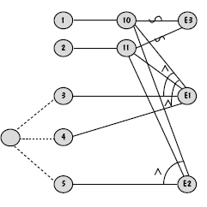
Chapter 9 Testing the System

Slide 31
Chapter 9 Testing the System
Table 9.2. Decision table for cause-and-effect graph.
Test 1
Test 2
Test 3
Test 4
Test 5
Cause 1
I
I
I
S
I
Cause 2
I
I
I
X
S
Cause 3
I
S
S
X
X
Cause 4
S
I
S
X
X
Cause 5
S
S
I
X
X
Effect 1
P
P
A
A
A
Effect 2
A
A
P
A
A
Effect 3
A
A
A
P
P

Slide 32
Chapter 9 Testing the System
9.3 Performance Testing
Focus on: performance test nonfunctional
^{addresses}requirement(in SRS)
1.Purpose and Roles
 performance testing : test for nonfunctional
requirement ( of <SRS> )
example : calculate the trajectory of a rocket
(the speed of response, accuracy, data accessibility, etc.)
 note :
A: performance testing(by a team) get result
give to developer and customer
B: hardware engineer € test team

Slide 33
Chapter 9 Testing the System
2. Types of Performance tests
several types of performance tests
A: stress tests（压力测试 / 强度测试）
(在短时间内加载极限负荷, 以验证系统能力)
B: volume tests（巨量数据测试 / 容量测试）
(验证系统处理巨量数据的能力)
C: configuration tests（配置测试） ---构建测试用例
对系统软硬件的各种配置(最小到最大)进行测试。
D: compatibility tests（兼容性测试）---测试接口等
E: regression tests (by old and new test cases)
F: security tests ( security requirement )
G: timing tests
H: environment tests

Slide 34
Chapter 9 Testing the System
I: quality tests
J: recovery tests
K: human factors test ( use interface-----usability)
focus on:
A: performance test ----more difficult than
function test（平时缺少必要的场景）
B: requirement must be explicit to ensure
performance test
C: requirement quality is often been reflected in
the ease of performance testing
(需求质量通常可以反映在性能测试的容易度上)

Slide 35
Chapter 9 Testing the System
9.4 Reliability,Availability,Maintainability
（可靠性，可用性，可维护性） (关于性能测试)
focus:A: performance test----Reliability, Availability,
Maintainability----is critical issues
B: it is difficult to measure directly before delivery
1. Definitions
software reliability : ( probability : 0 1 )
----软件系统在给定的时间间隔和给定条件下运行
成功的概率
availability: ( 0/1 )
----软件系统在给定的时间点（按SRS要求）成功
运行的概率

Slide 36
Chapter 9 Testing the System
maintainability: ( 0 1 )
----是指在给定的使用条件（预定的时间
间隔、维护程序、维护资源之下进行维
护）下，维护活动能被执行的概率
2. Four different levels of failure severity(严重性)
A: reason: because reliability, availability, and
maintainability are defined in terms of
failures, they must be measured once
the system is complete and working
B: four different levels ( P438)
3. Failure data : 根据失效时间记录，来理解系统的不确定性，
以图改进. 或者以此理解系统可靠性的改进程度.

Slide 37
Chapter 9 Testing the System
9.5 Acceptance Testing（确认/验收测试）
1. Purpose and roles
 acceptance testing: customer check if the
system meet the need in
requirement definition
 roles: customer ----play large roles ( in
acceptance test，customer write,
conduct, and evaluate the test result)
developers----play small roles (answer or
explain technical questions when the
customer requests)

Slide 38
Chapter 9 Testing the System
2. Types of Acceptance tests
 benchmark test（基准测试） ( formal test )
A: customer prepare test cases (with formal cases)
B: install on experimental basis
C: customer evaluate the performance
 pilot test（引导测试） (informal test)
A: user/developer install on a experimental basis
B: pilot test rely on daily working(no formal cases)
alpha test: pilot test in organization (by developer)
beta test: customer’s pilot (in working site)
example ---microsoft corporation’s test strategy

Slide 39
Chapter 9 Testing the System
● Parallel test
A: definition:
（新老版本并行运转，使用户逐渐适应新版软件系统。）
X: used in phased development model
Y: new system operates in parallel with the
previous version (no formal test cases)
B: features:
X: users will be gradually become accustomed
to the new version (by comparing and
contrasting them)
Y: allowing the skeptical users to build their
confidence in the new version

Slide 40
Chapter 9 Testing the System
3. Results of Acceptance Tests
 It is the customer’s chance to verify that what
was wanted is what was built.
 It will help customer to discover ambiguous
aspects (in definition) .
● Change in requirements may be needed.
❍ Configuration management staff identify the
changes and record other modifications in
design , implementation, and testing
（客户根据验收测试的结果，将告诉开发方哪些需求没有得到满足，哪些是因为需求变化而必须删除、修改或增加，配置管理人员将配合记录软件所有阶段的变更。）

Slide 41
Chapter 9 Testing the System
9.6 Installation Testing（安装测试）
1. definition: testing in user’s environment (to solve
the problems caused by the differences
between the developing environment
and the user’s environment)
example: the primitive data file and devices
2. focus on: (about installation testing)
A: completeness (of the installed system of
functional or nonfunctional features)
B: verification: final checking (in working site)
example : system working in a ship 。

Slide 42
Chapter 9 Testing the System
本章作业：
课本练习题:第5、6、8、12题。
（以上都是问答题）

